Slide 1
Course Title: OOP 2 Course Code: CSC 2210
Dept. of Computer Science
Faculty of Science and Technology
Topis: C# Basics
Lecturer No: | 1 | Week No: | 1 | Semester: | Fall 2022-23
Lecturer: | Nyme Ahmed (nyme.ahmed@aiub.edu)

Slide 2
Lecture Outline
Assessment and Evaluation
Rules and Guidelines
Introduction about C#
Installation Guidelines
First C# Program and Syntax
Value Types
Type Casting
C# User Input
C# Operators
Strings

Slide 3
Assessment and Evaluation
Assessment strategy for Mid term:
Attendance
Quiz (Best 1 out of 2)
Lab Exam
Mid Exam

Slide 4
Assessment and Evaluation
Grading Policy:
Marking System for Mid |  | Marking System for Final
Attendance | 10 | Attendance | 10
Quiz | 20 | Performance | 10
Lab Exam | 20 | Quiz/ Assignment | 20
Mid Exam | 50 | Project + Viva | 40 + 20
Total | 100 | Total | 100
Grand Total: Mid 40% + Final 60%

Slide 5
Rules and Guidelines
Must be present inside the class in due time.
Break time: 15-20 minutes (max) break will be given in the middle of the class.
Must have at least 80% attendance to pass this course. Failure to do so will result in an automatic UW.
Must appear in the mid exam.
No make-up quiz/lab exam.
No bonus request! (May be given for any good performances)
No cheating, you’ll get an F in the course.

Slide 6
Introduction about C#
C# is an object-oriented programming language created by Microsoft that runs on the .NET Framework.
C# in case-sensitive.
C# is used for mobile/desktop/web/database applications, websites, games and many more.
Tool used for C#: Microsoft Visual Studio

Slide 7
Introduction about C#
Why we need C#?
Most popular object-oriented language which gives a clear structure to programs and allows code to be reused, lowering development costs.
Easy to learn and simple to use.
Has a huge community support.

Slide 8
Installation Guidelines
We will use Visual Studio Community.
Link: https://visualstudio.microsoft.com/vs/community/
After downloading the VS Community, choose the “.NET desktop development” and click on the Install button.
After installation, Visual Studio will automatically launch.
Then set the development settings from ‘General’ to ‘Visual C#’. After that, click ‘Start Visual Studio’.

Slide 9
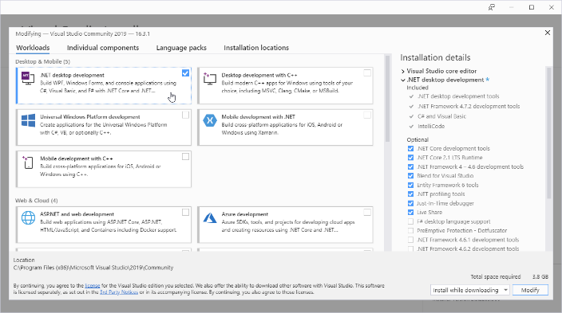
Installation Guidelines

Slide 10
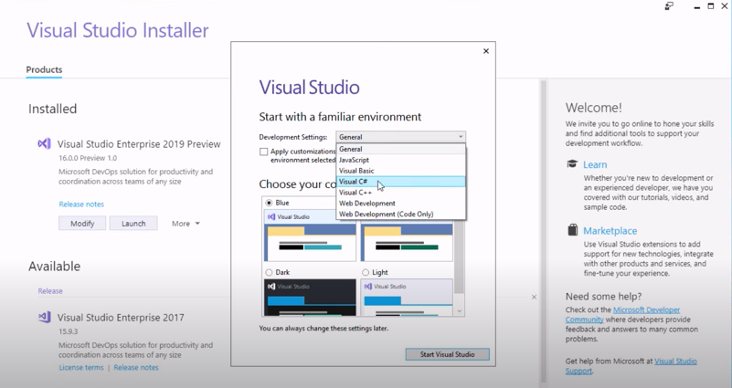
Installation Guidelines

Slide 11
First C# Program and Syntax
using System;
namespace ProjectName
{
class Program
{
static void Main(string[] args)
{
Console.WriteLine("Hello World!");
}
}
}

Slide 12
First C# Program and Syntax
using System means that we can use classes from the System namespace.
namespace is used to organize your code.
class is a container for data and methods. Every line of code that runs in C# must be inside a class.
Another thing that always appear in a C# program, is the Main method. Any code inside its curly brackets {} will be executed.
Console is a class of the System namespace, which has a WriteLine() method that is used to print text.

Slide 13
Value Types

Slide 14
Type Casting
Type casting is when you assign a value of one data type to another type.
In C#, we can perform the following type casting-
Implicit Casting: Converting a smaller type to a larger type. (char -> int -> long -> float -> double)
Explicit Casting: converting a larger type to a smaller type. (double -> float -> long -> int -> char)
Conversion with the helper classes

Slide 15
Type Casting
Implicit Casting: Done automatically when passing a smaller size type to a larger size.
Example:
int myInt = 12;
double myDouble = myInt; // Automatic casting: int to double
Console.WriteLine(myInt); // Output: 12
Console.WriteLine(myDouble); // Output: 12

Slide 16
Type Casting
Explicit Casting: Must be done manually when passing a larger size to a smaller size.
Example:
double myDouble = 3.95;
int myInt = (int) myDouble; // Manual casting: double to int
Console.WriteLine(myDouble); // Output: 3.95
Console.WriteLine(myInt); // Output: 3

Slide 17
C# User Input
Console.WriteLine("Enter your university name:");
string name = Console.ReadLine();
Console.WriteLine("University name is: " + name);
Remember that Console.ReadLine() method returns a string.

Slide 18
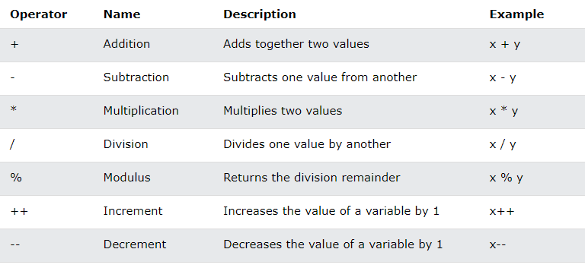
C# Operators
Arithmetic Operators:

Slide 19
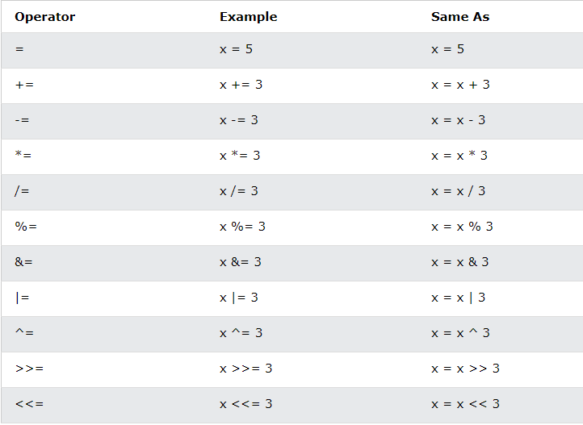
C# Operators
Assignment Operators:

Slide 20
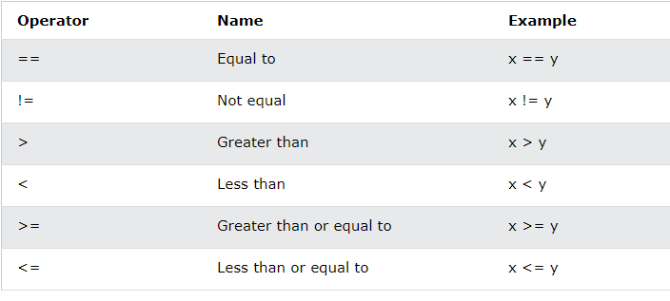
C# Operators
Comparison Operators:

Slide 21
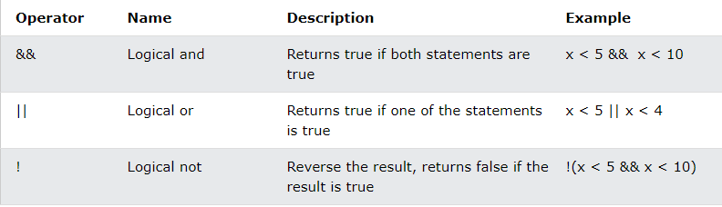
C# Operators
Logical Operators:

Slide 22
Strings
A string variable contains a collection of characters surrounded by double quotes.
String length: By using the Length property.
string txt = “Hello World!”
Console.WriteLine(“Length is: " + txt.Length);
Upper-lower conversion: By using ToUpper() and ToLower()
string txt = "Hello World!";
Console.WriteLine(txt.ToUpper());
Console.WriteLine(txt.ToLower());

Slide 23
Strings
Concatenation: + operator is used.
string firstName = "Anik “;
string lastName = "Islam";
string name = firstName + lastName;
Console.WriteLine(name);
Also used string.Concat() method.
string firstName = "Anik “;
string lastName = "Islam";
string name = string.Concat(firstName, lastName);
Console.WriteLine(name);

Slide 24
Strings
Access String: by referring to its index number inside [].
string x = “AIUB";
Console.WriteLine(x[1]);
Special Characters: by using \”
string x = "AIUB is in \"Dhaka\"";
Console.WriteLine(x);

Slide 25
Strings
C# uses the + operator for both addition and concatenation.
Numbers are added.
Strings are concatenated.
int x1 = 5;
int y1 = 5;
int z1 = x1 + y1;
Console.WriteLine(z1);
string x2 = “5”;
string y2 = “5”;
string z2 = x2 + y2;
Console.WriteLine(z2);

